Slide 1
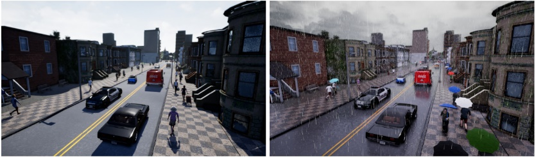
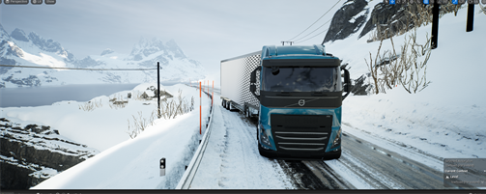
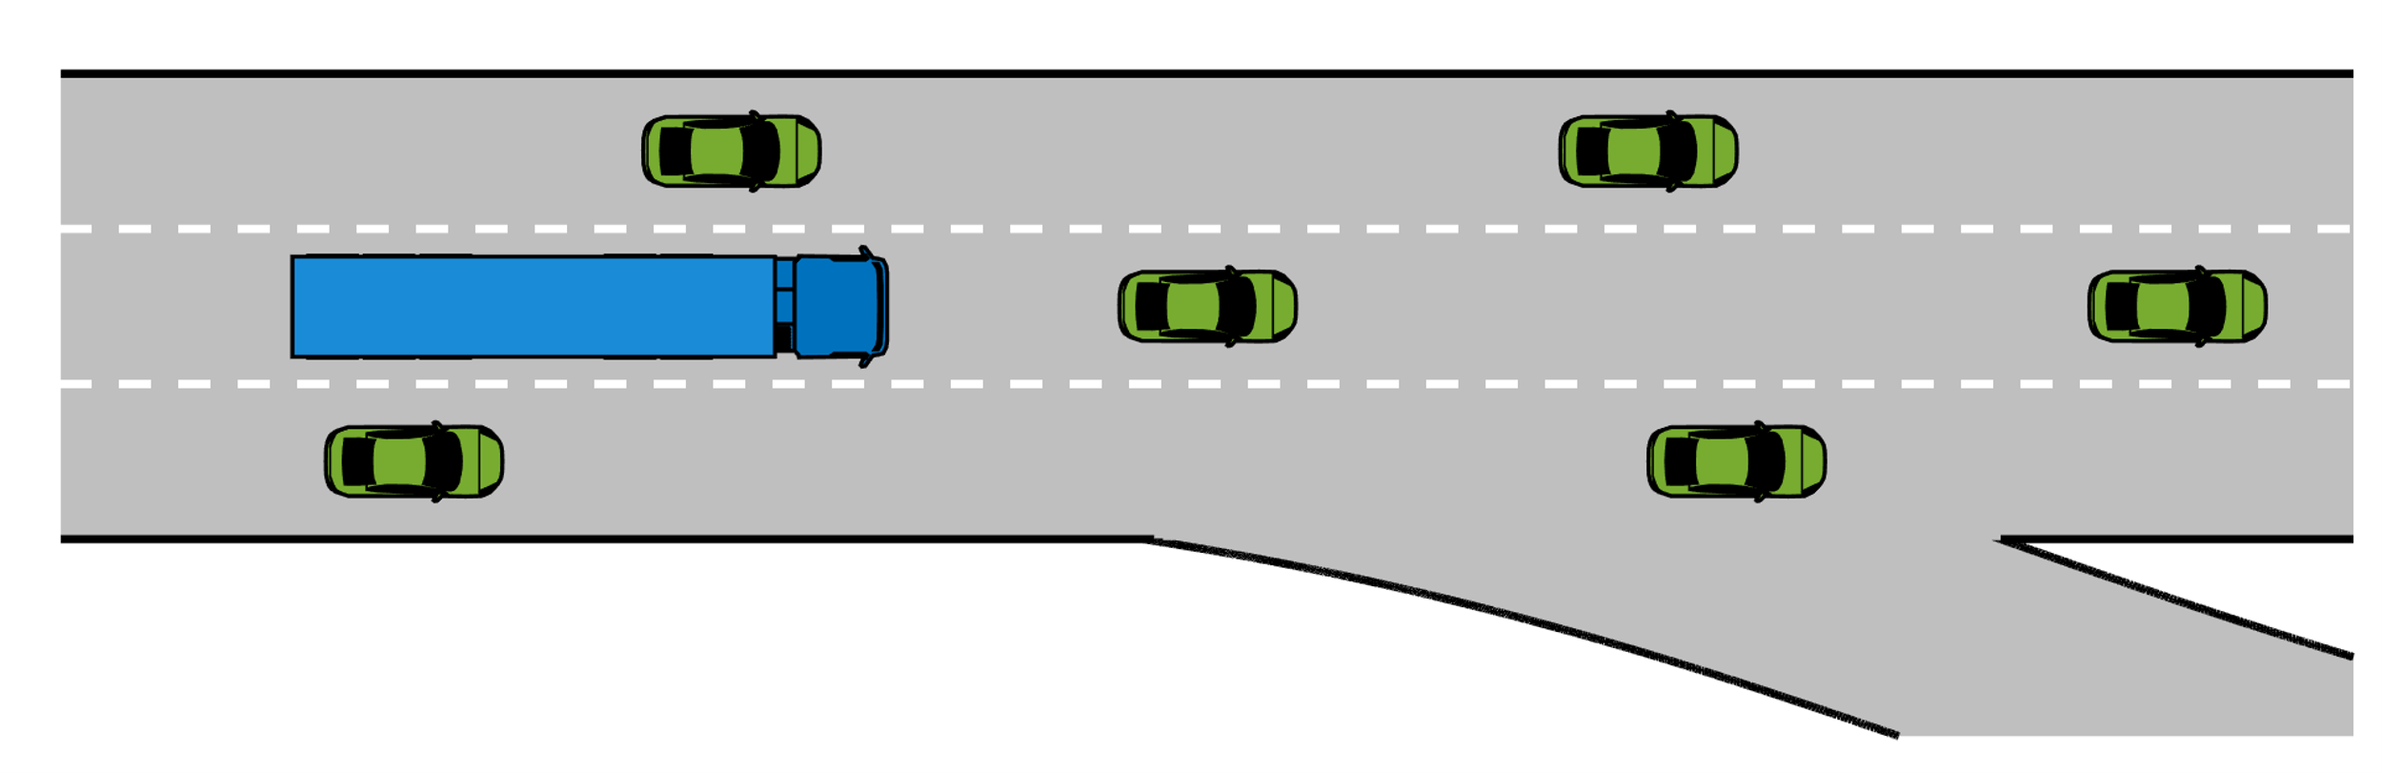
Robust Predictive Control for a Heavy-Vehicle in an Uncertain Environment
Students: Saeed Salih & Qun Zhang
Goal: Safe, Predictive Control that accounts for uncertainties:
Path Planning with < 10 second horizon.
Uncertainties could affect: 1. Sensing; 2. Dynamics; 3. Obstacles
Key Methods: Model Predictive Control, Chance-Constraints, Vehicle Dynamics Modelling
Fig 1. Simulations in CARLA. (a): City traffic in varying weather conditions (b): High-fidelity model of Volvo Truck.
Tools: CARLA simulation environment, ACADOS/CasADi for optimization solver, primarily programming in Python
Supervisors: Erik Börve (Chalmers/ADAS GTT)
Prof. Nikolce Murgovski (Chalmers E2)
Prof. Leo Laine (Chalmers M2/SED GTT)
Fig 2. Illustration of a complex traffic scenario with an HVC approaching a highway exit.

Slide 2
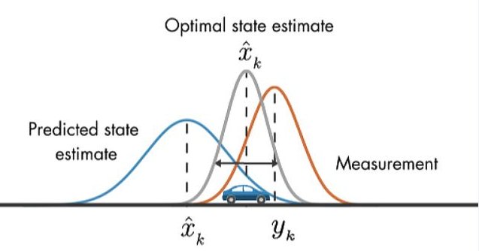
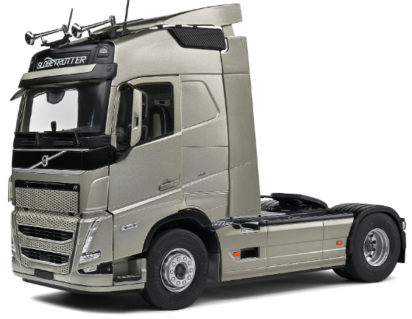
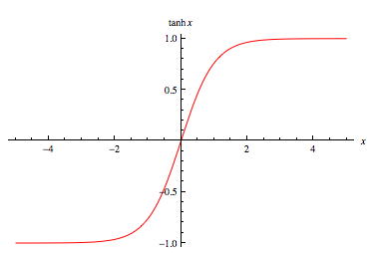
Architecture
Extended Kalman Filter
Uplevel controller (MPC)
States
Lidar
Steering
Process Propagation
Position
Constraints
IMU
Velocity
Measurement Update
Heading Angle
MPC Controller
GPS
Target State
Throttle/Brake
Longitudinal Control
Measurement
Lateral Control
Steering
Local controller (PID)
Scaled by tanh(x)

Slide 3
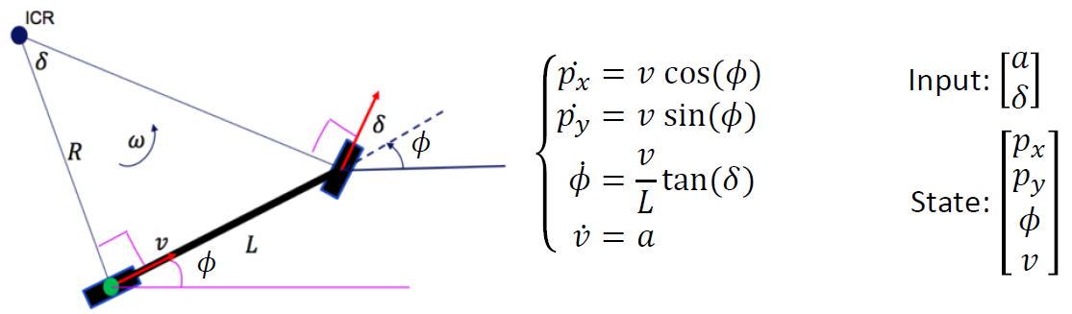

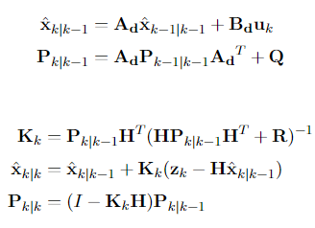
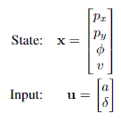
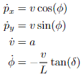
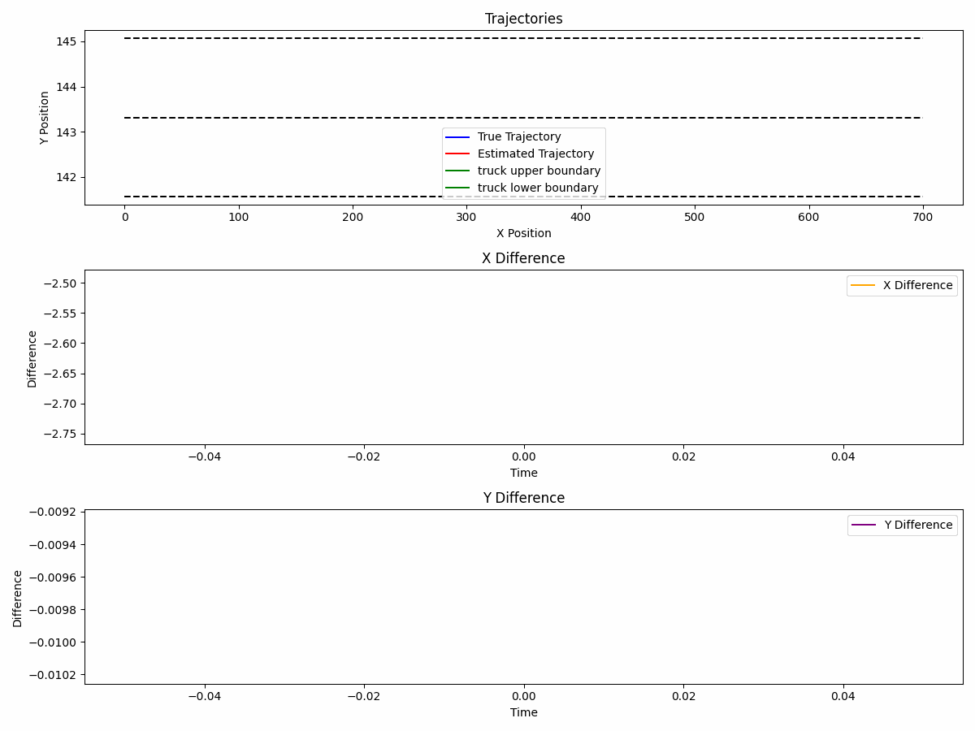
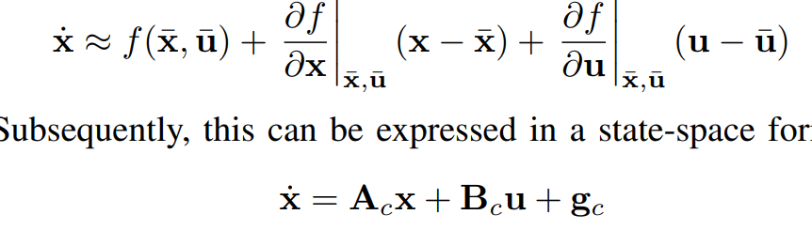
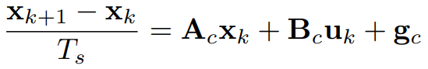
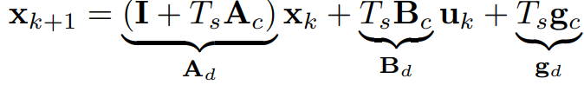
Process Model(Using LTV Model)
Extended Kalman filter
Process Predict(Kalman filter)
Measurement Update(Kalman filter)
H is Identity matrix
Stationary P is used to calculate tighten bound

Slide 4
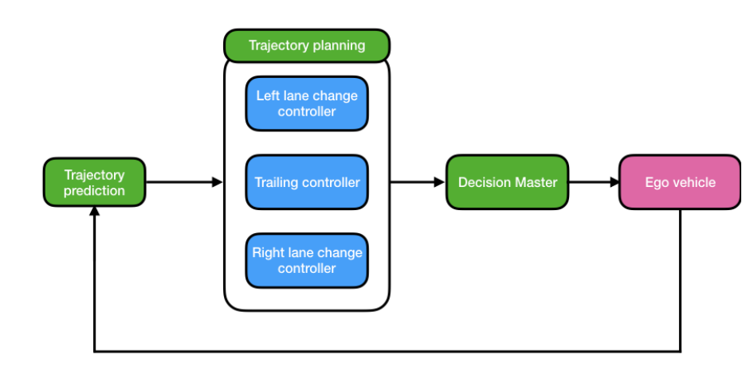
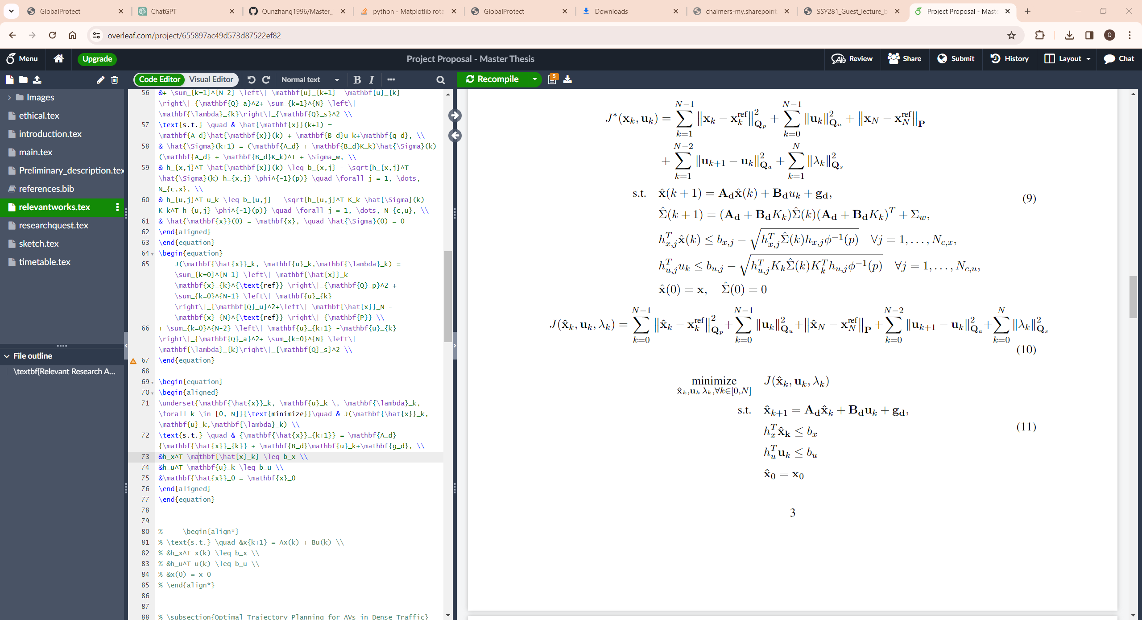
MPC Controller
The highway autopilot uses a trajectory planner and three predictive controllers for trailing and lane changes, employing vehicle prediction to optimize trajectories via a Decision Master.
Each cost function aims to track trajectory while minimizing the control input and the change of the input.

Slide 5
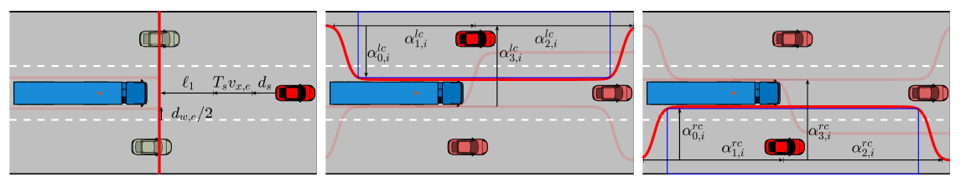
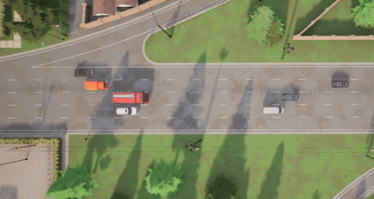
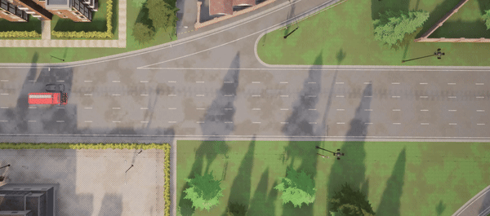
MPC Controller Constraints
Trailing Controller
Left Lane Change Controller
Right Lane Change Controller
The Trailing Controller operates within the boundaries set by Intelligent Driver Model (IDM) constraints.
The Lane Change Controllers adhere to limits through a smooth approximation using tanh functions.

Slide 6
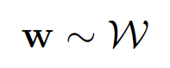
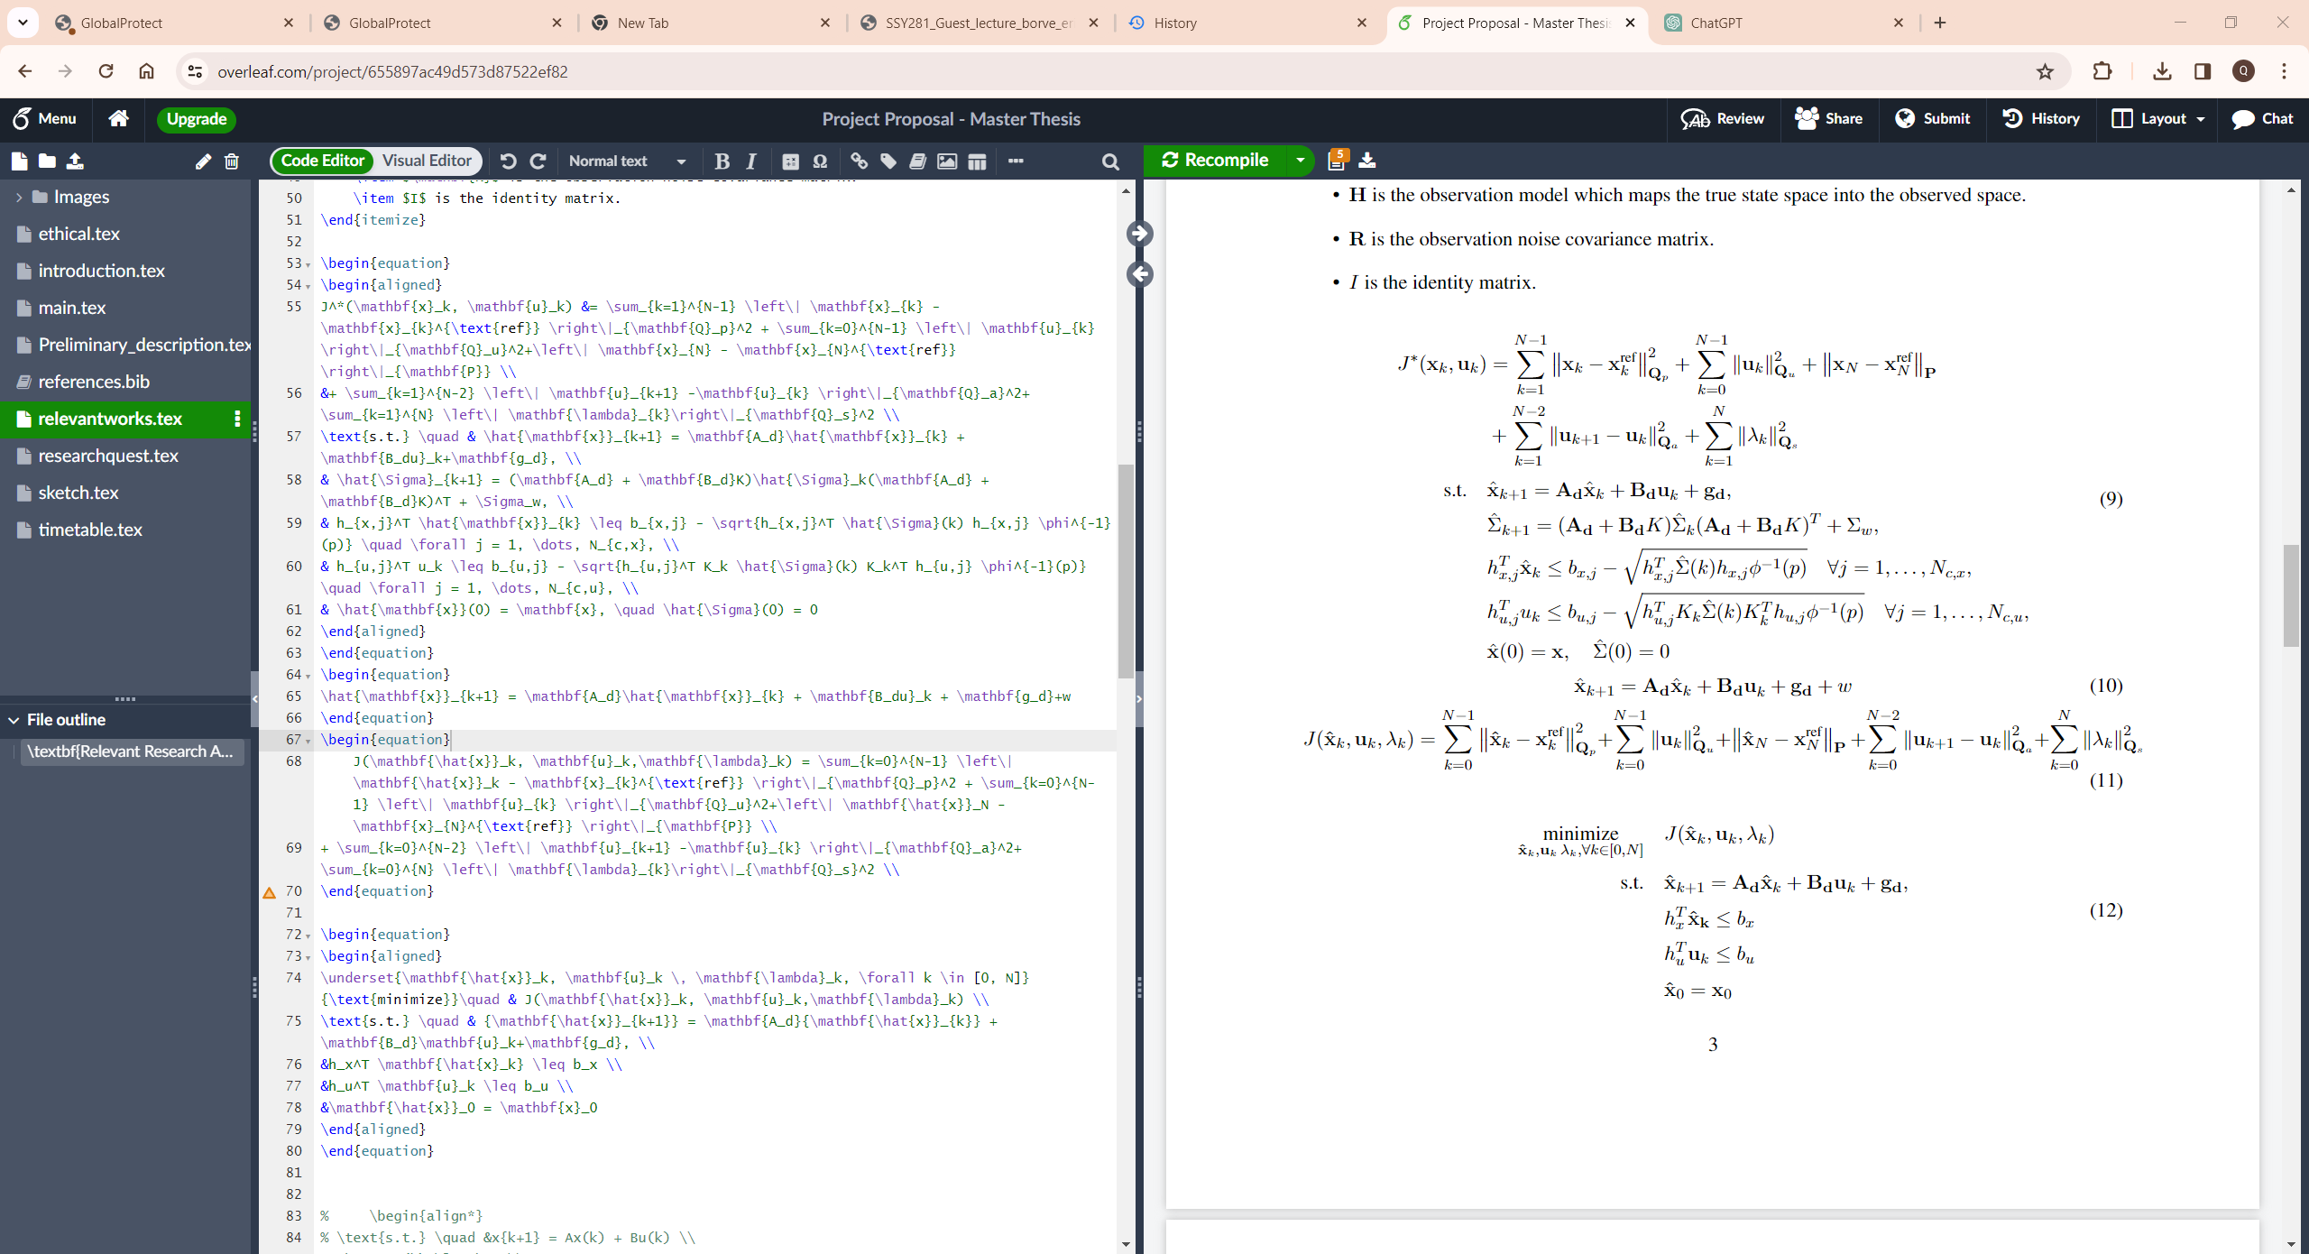
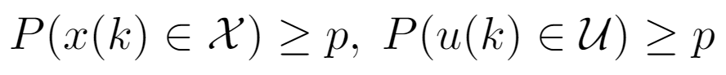
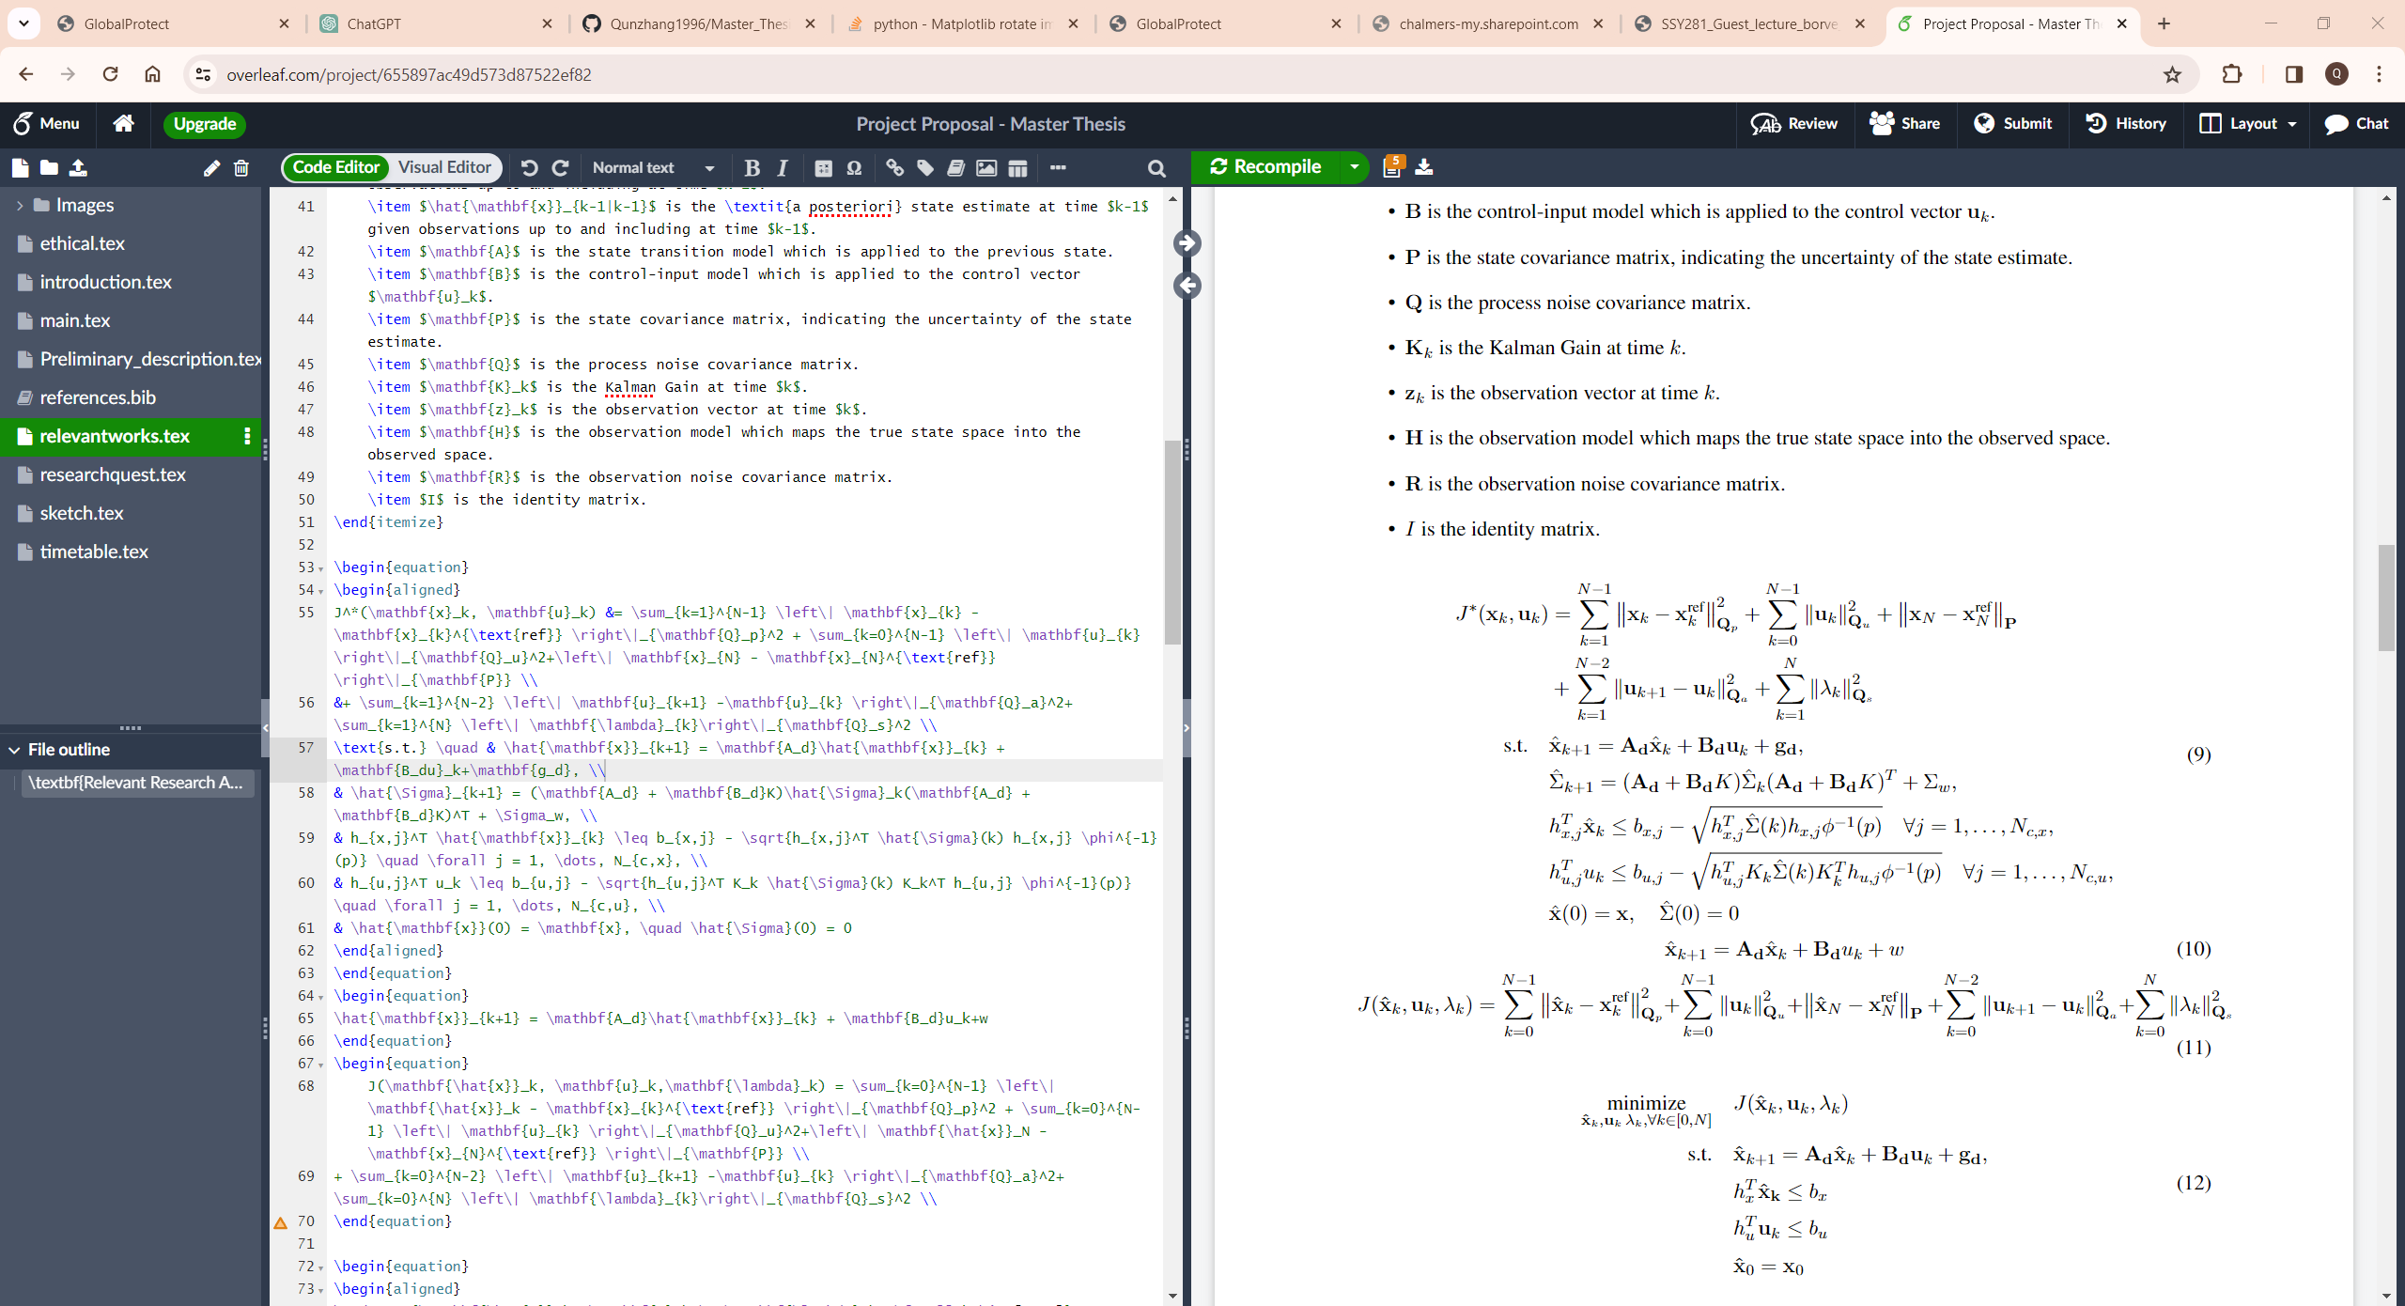
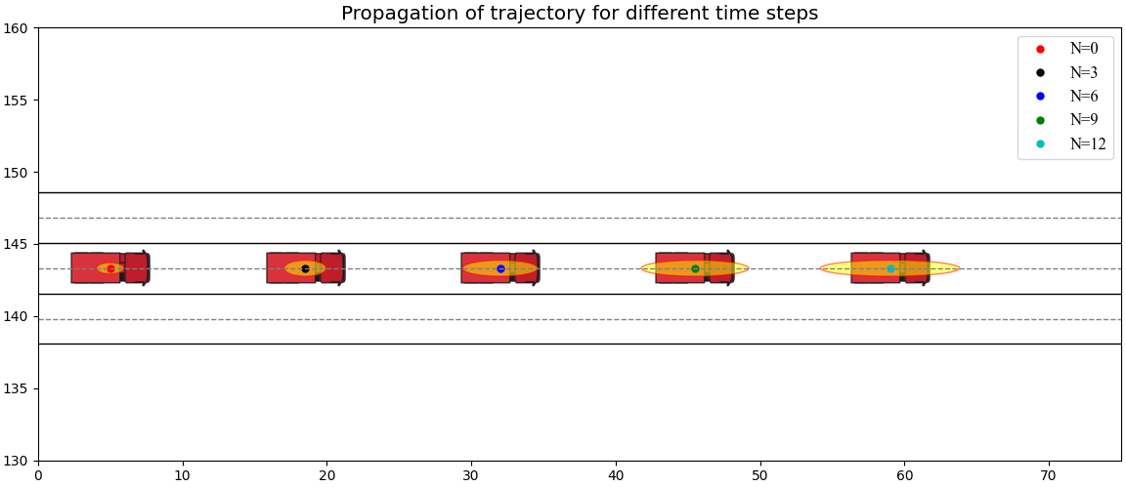
Stochastic​ MPC
As time progresses, the influence of noise on the system escalates, significantly affecting the positioning accuracy of the ego vehicle.
Stochastic​ MPC Settings
Uncertainty follows some i.i.d distribution
Constraints are satisifed with some probabilty
Soft constraints guarentees, violation can happen, but are unlikely (Chance-Constraints).
Why use Stochastic​ MPC
Always accounting for very unlikely scenarios can yield poor performance.
We can trade off risk and performance by tuning constraint satisfaction level (p).
Explicitly treating violations → ’’graceful’’ recovery

Slide 7
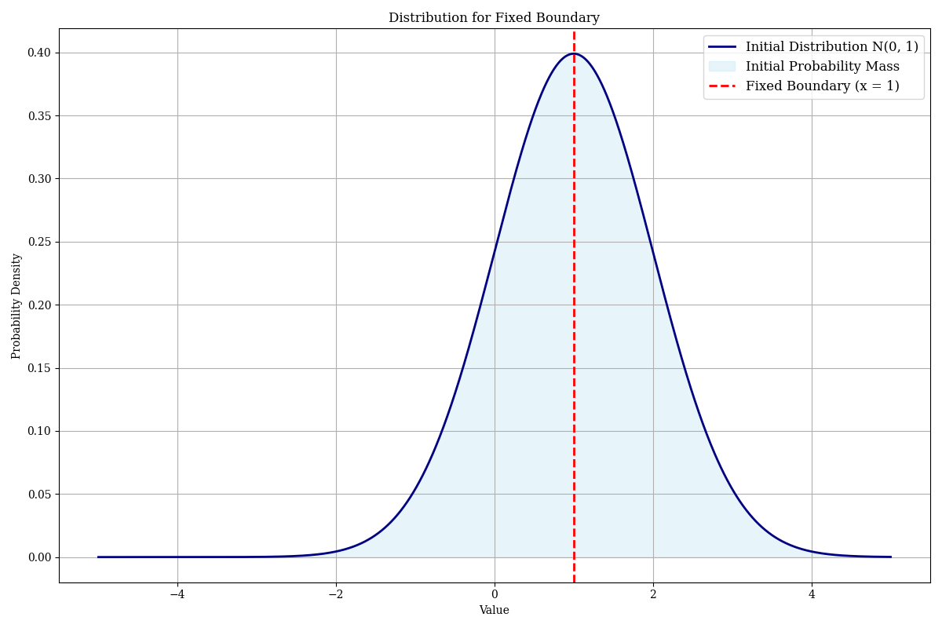
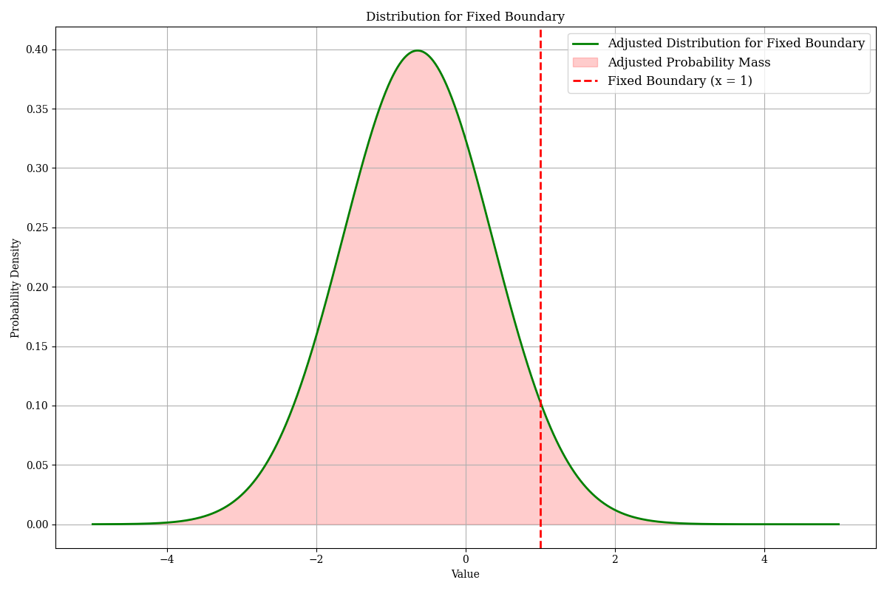
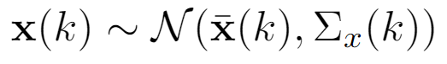
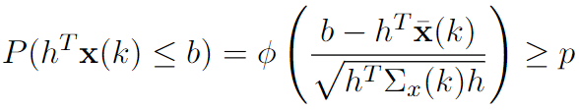
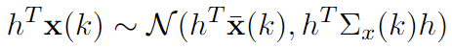
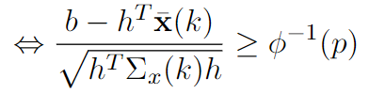
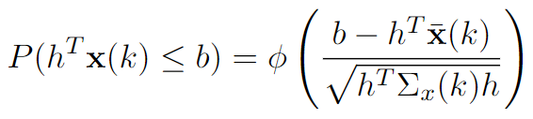
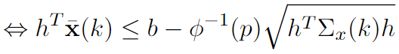

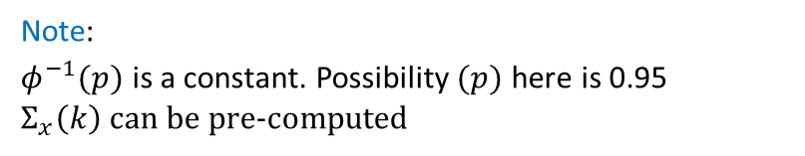
Stochastic​ MPC Setting
Note:
$φ^{−1}(p)$ is a constant. Possibility $(p)$ here is 0.95
$Σ_{x}\left(k\right)$ can be pre-computed

Slide 8
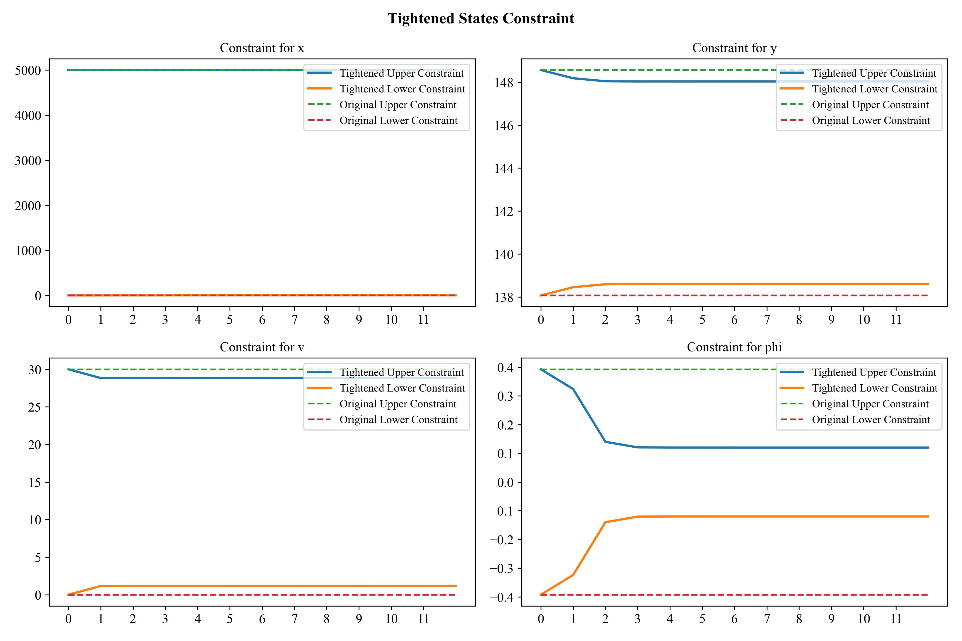
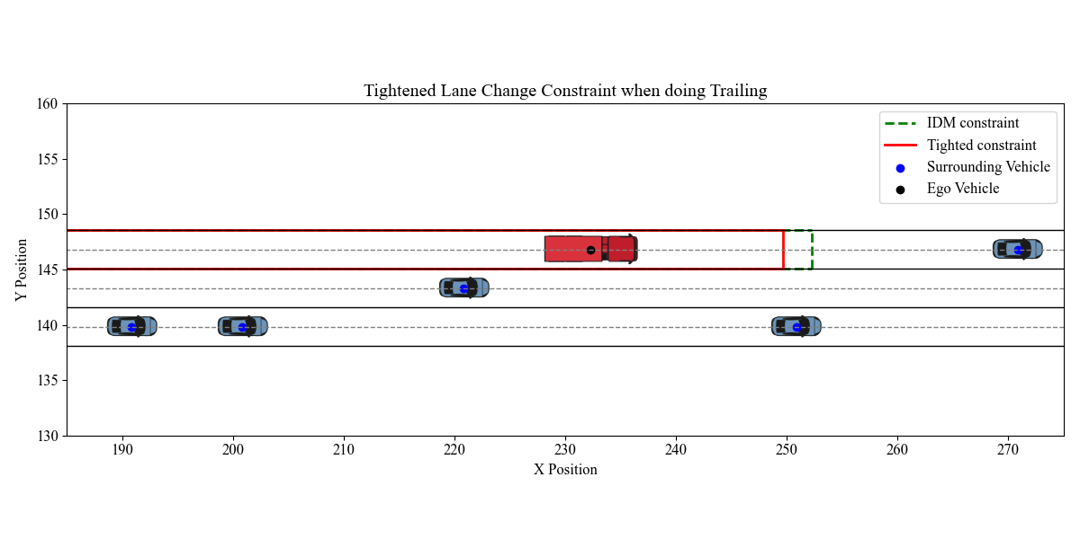
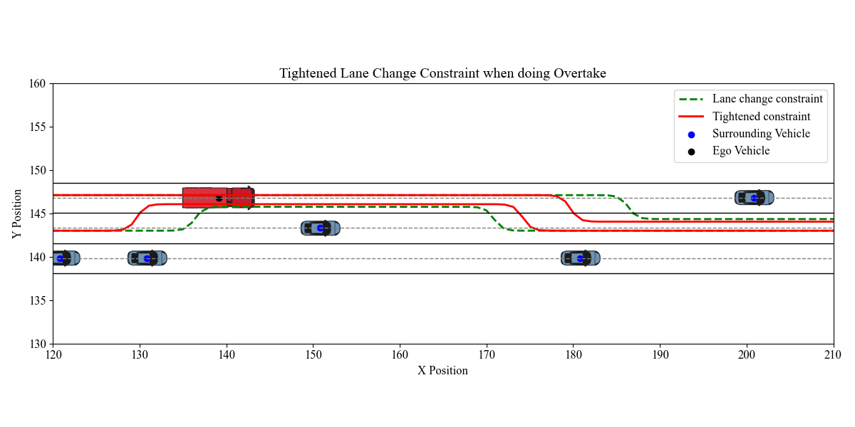
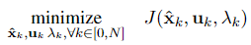
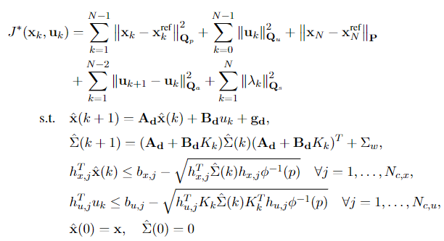
Constraints Tightened by Stochastic​ MPC

Slide 9
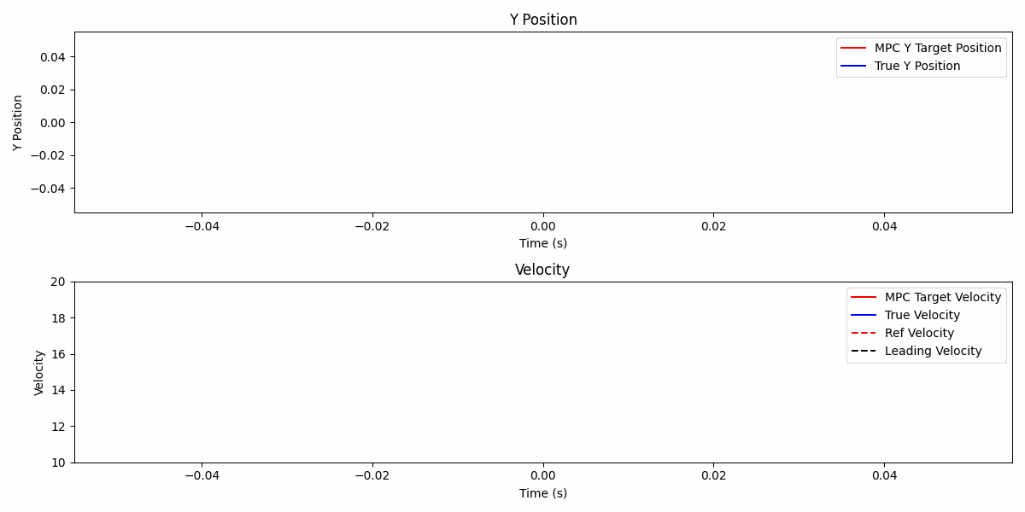
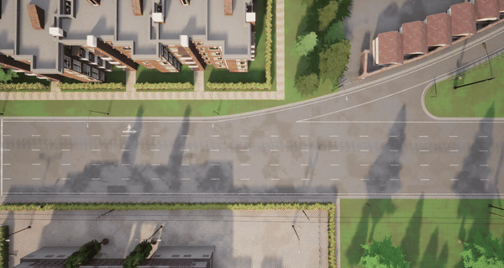
Simulation In CARLA Environment
4X

Slide 10
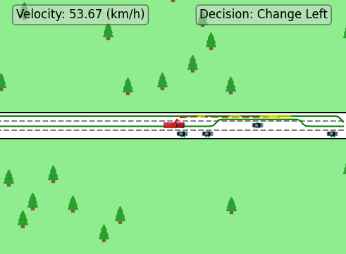
Constraints In Simulation

